Slide 1
More info about Competition
Ⓒ 2018 ECSESS RoboElectronics Committee, Slides adapted from Dirk Dubois

Slide 2
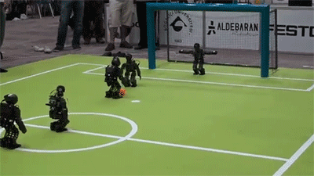
Soccer tournament!

Slide 3
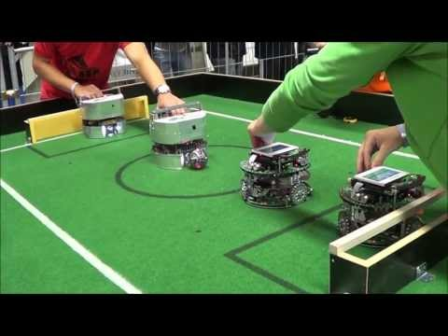
How will be like

Slide 4
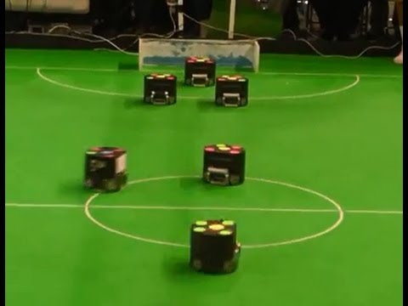
More example

Slide 5
Rules
Each team is required to complete their robot in order to participate the competition.
Robot can have an arm to kick or push the ball however, it is not allowed to grab or carry the ball (see video from previous slides)
Team who scores the first 3 goals wins a game
More wins = More points
Extra points will be given for creative design (physical) and coding

Slide 6

Prize!
Winning team will receive Arduino UNO
which is one of the most famous microcontroller for DIY
As mentioned on the first lecture, prize is
limited to max 4 people
(i.e. 4 arduinos per group)

